Slide 1
Low Noise Amplifier Proof of Concept
NITHIN P

Slide 2
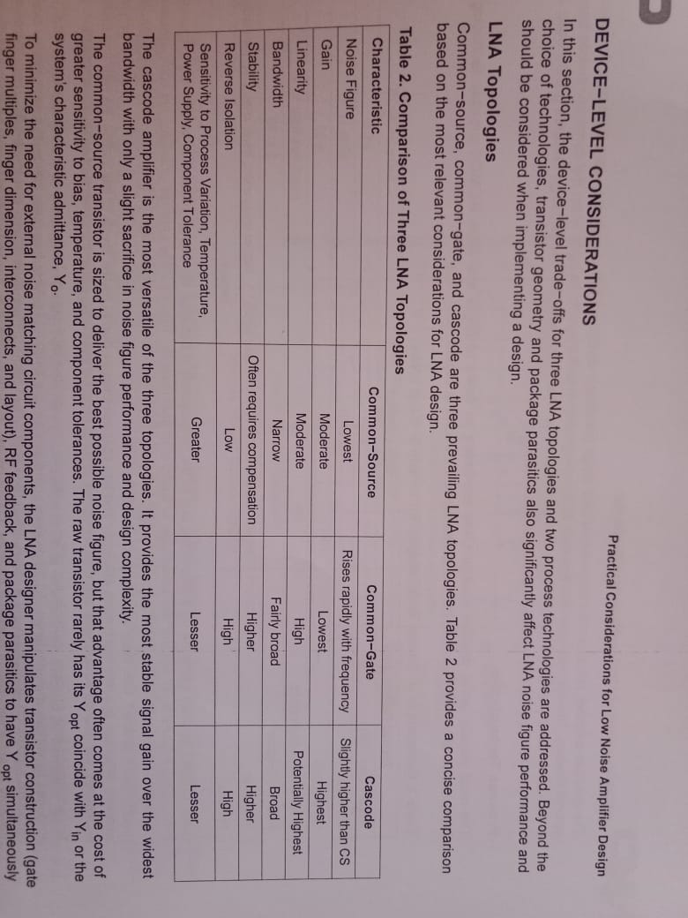
Design Methodology :
Common Source topology
Common Gate Topology
Common Source with resistor feedback
Cascode topology with inductor degeneration
The below results have been experimentally verified

Slide 3
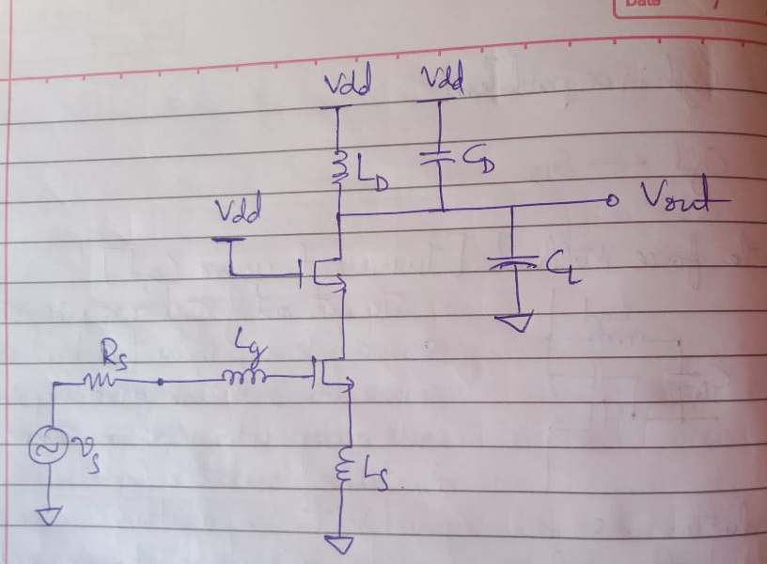
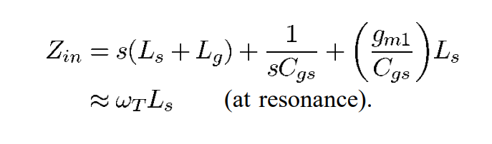
Cascode LNA Design
Impedance Matching:
Zin look at the input terminal of the main MOSFET is
Here we’ve to ensure that all the inductor and capacitor network we are using resonates at the frequency we desire(4-5GHz)
Here we can also have extra Capacitors for additional purposes like ESD Protection and Design consideration (parallel to Cgs)

Slide 4
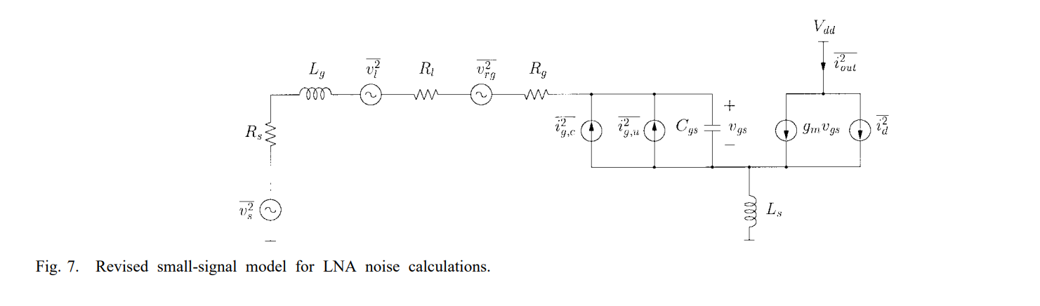
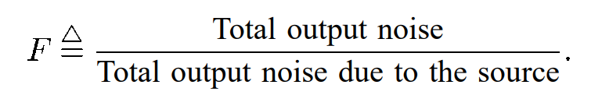
Noise Consideration
The Above fig represents all Noise causing elements modelled with either noise current or voltage source
The main noise causing elements within a design is Resistors which cause Thermal noise
Here in the design we’ve mainly 3 noise considerations (many others are present but these are the major )
Source Resistance (Rs) – Thermal Noise
Gate Resistance (Rg) – White Noise
Channel Noise Produced by Gate Terminal

Slide 5
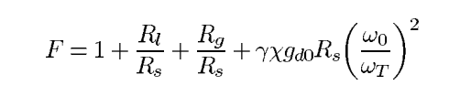

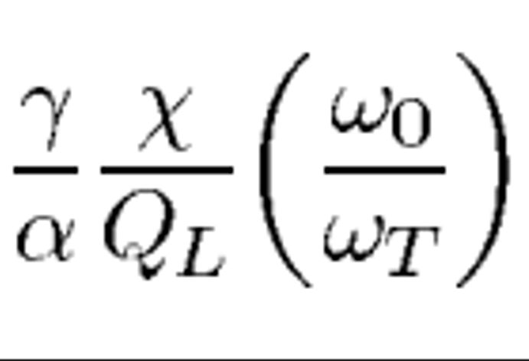



F represents Noise Figure
As We can very clearly see noise generation is because of Rs, Rg and
So good way to design is Consider the design is Calculating Fmin, So that You know what's the max limit upto which you can limit the F
This is done with the help of 2 method
Gm optimization
Pd(Power Dissipation ) optimization
Turns out that 2nd method is much more accurate and better
Fixed Pd Optimization:
we can optimize this making many assumptions and we get the value of QL (because w
And wT are fixed and QL can be changed) we get Optimum QL to be
After substituting many values and assuming that Gm is fixed for a MOSFET, We get

Slide 6
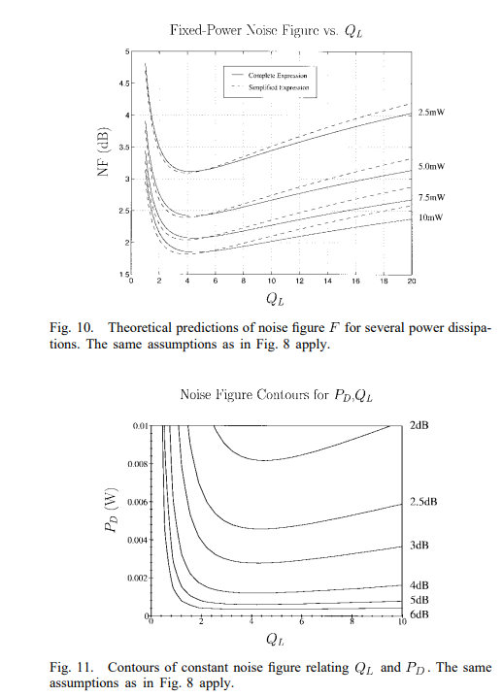
1.62 is valid for Long channel mosfets only .
The NF, QL and Pd optimization can be done easily with the help of this experimental plot
But there are multiple problems here:
This has been assumed that perfect input and output match has been done
In this method the optimum series resonance frequency is 15% off from the desired frequency
Here we should also balance drain noise and gate noise together
Turns out that Rs can be varied to fix the shifted resonant frequency by varying Rs which has been done by the T.Lee paper , but we will not use this because this is risky and we might need to redo the design , also Gm is inverly proportional to Rs , so Varying Rs can affect our gain and gate noise
Possible solution:
Increasing wT by choosing better MOSFET devices
Rg can be decreased with the use of fingers at the gate terminal which decreases the Rg based white Noises, which is possible in the software I use.

Slide 7

Drain Noise Optimization :
Drain noise can be optimized similarly how we optimized Rs
Note that here we’ve considered CL also note that CL is a mixer and as the design states ,its better to keep the design independent of Mixer Load
Help: Knowing CL will be useful for design calculation simplification.

Slide 8
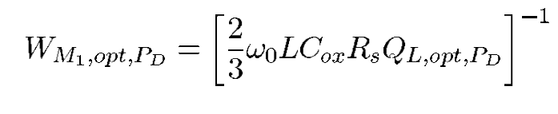
LNA Design Implementation
Fix power Consumption from fig 10,11 and choose the Pd and accordingly check for NF
Problem: fig 10,11 are based on 600nm design so it might not be accurate for modern MOSFET design, So Beware
Here we fic the length of the MOSFET for minimum possible length to avoid channel modulation and avoid additional channel originated noise, the below equation clearly represents the dependency of width and Pd
So choosing Optimum Pd is essential for low NF
Help: So knowing Pd value will be essential for the design calculation and determining the NF.
There is a possibility of increase in NF if Systems are not grounded properly or supply voltage sources and ground connection having parasitic Resistance and inductance is a real possibility and has to be taken into consideration when doing the real LNA device design
Also there is a possibility of adding extra networks(mainly MOSFET containing devices ) to ensure proper biasing and Input/ output matching
Certain inductors might even be possible to be put on chip (which is a good thing) rather off the chip

Slide 9
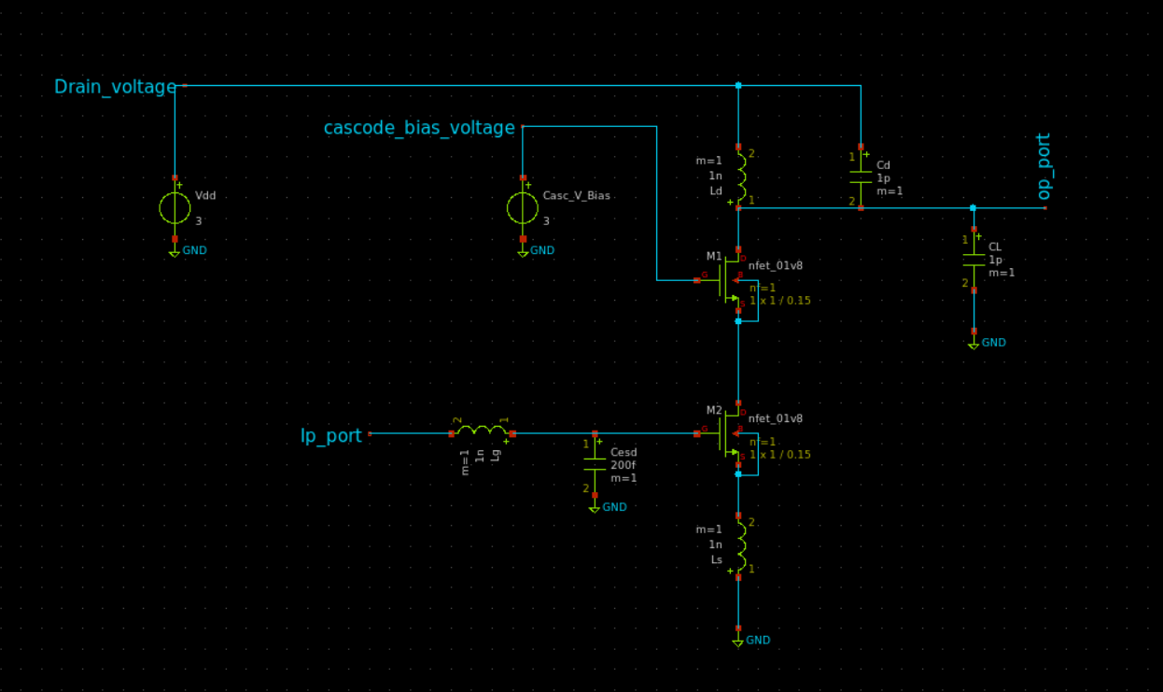
Possible Schematic
Note that the values used in the above figure are incorrect and need to be recalculated

Slide 10
Problems I’m facing in the design and you might encounter
The design I’m using is based on CMOS devices which is the second worst taking into consideration of NF
Not Much gain with NF compensation we get (mainly because of the MOSFET device we use
Note that possible gain and NF obtainable from this single stage design is somewhere near 20dB(<20dB) but can be enhanced by adding additional gain enhancing circuits and can be pulled up to (<25dB)
Note for real devices requiring 60dB gain we need to cascade these single stage and increase gain, but care needs to be taken to ensure stability, Proper impedance matching, Poles consideration is being done. Note that there are design which has been done on this methodology utilizing 2 or more than two stages to increase the gain, but there will be obvious NF increase which has to be taken into consideration.
Absence of considerable data for design consideration like NF, S parameter, Id, Technology being used.
Biasing and Characterising the MOSFET for the requirement is a painstakingly slow and tedious and takes a lot of iteration to arrive at desired characters .
Obtaining MOSFET parameters like gd0, α, Gamma, δ and many other parameters of mosfet is very difficult and some software don't have a way to simulate and obtain these parameters these parameters, and a rough estimation has to be done which have to be tuned to rectify the possible errors in the design
Majorly this a very slow process so this needs to automized with some computer program(Design Process for this spec)
Also the design we employed here is broadband rather than wideband

Slide 11
Cautions to be taken
Layout has to be taken very seriously because the layout will alter our design and might introduce additional parasitic components and the results are bad (I’ve not taken this into consideration because I don’t know Analog/RF layout)
Care needs to be taken while using the fingers at the gate terminal
And Many others (Refer the design book)

Slide 12
Solutions to the observed problems in my design procedure
Use Better Software like Keysight ADS(Advance Design system) which are custom made for RF Design but Keysight ADS is not free, Serenade is another RF Design Software which is free and open source but this might lack some features as compared to ADS .
Remember the painstaking MOSFET Characterization, ADS solves this problem by giving pre-modeled MOSFETs called devices like ex: ATF 21170 which has been used here (https://youtu.be/iGkWnvuHGHw?si=AtakfVcIeWPHIR2o) for 2.4 GHz LNA Design .
Don't use CMOS Devices at all, Use GaN or GaAs devices which offer way better gain and noise performance which are available in ADS Software
There are many specialized components meant for proper Impedance Matching, Biasing and many other real life application problem rectification present in ADS
There is a provision to use high power application MOSFET (Vdd=20V) present in 130nm Technology, but there are many problems that can be seen like high gate noise because of Oxide thickness but gain will be higher, Also I’ve not been able to find the spice directory for this MOSFET.
Have Large Team where you distribute the load and do things that you are good at rather do everything
THANK YOU
NITHIN P

